Slide 1


FORENSICS
2 - Disks, Network
!! nos4a2
@sluzypt
AFSC19.EXE @afsc19

Slide 2
ROAD
MAP
1. Foundations
2. Disks, registries, network
3. Memory
4. ???

Slide 3
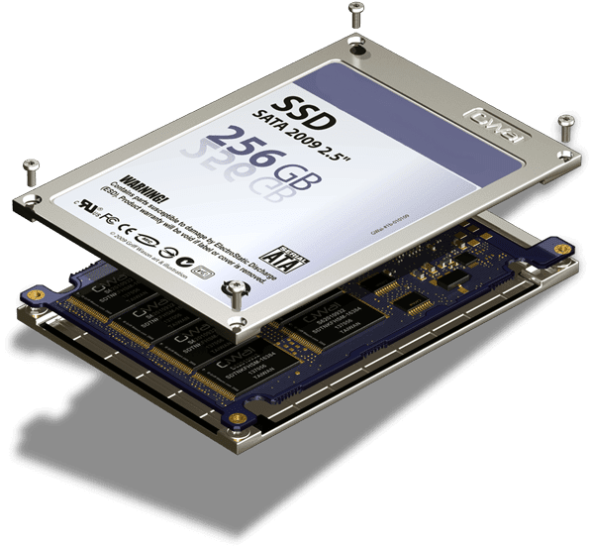
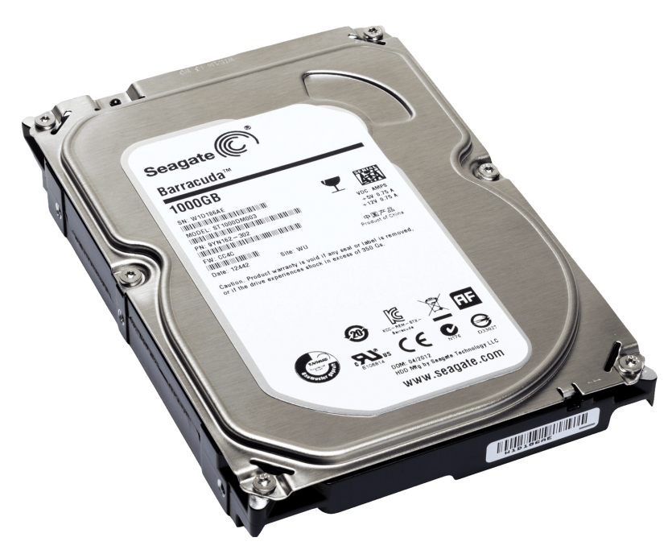
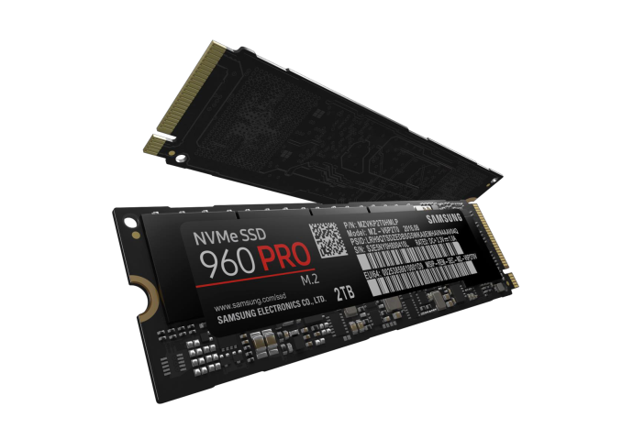
Disks/volumes

Slide 4
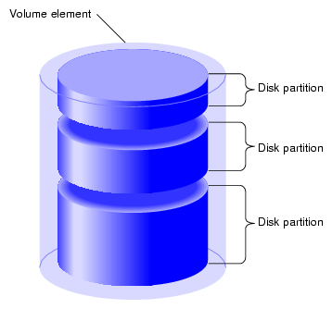
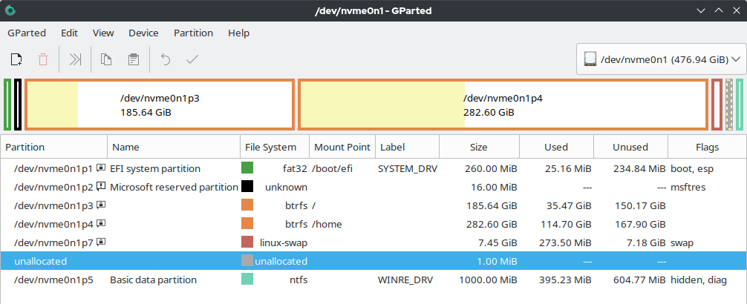
Disk partitions

Slide 5
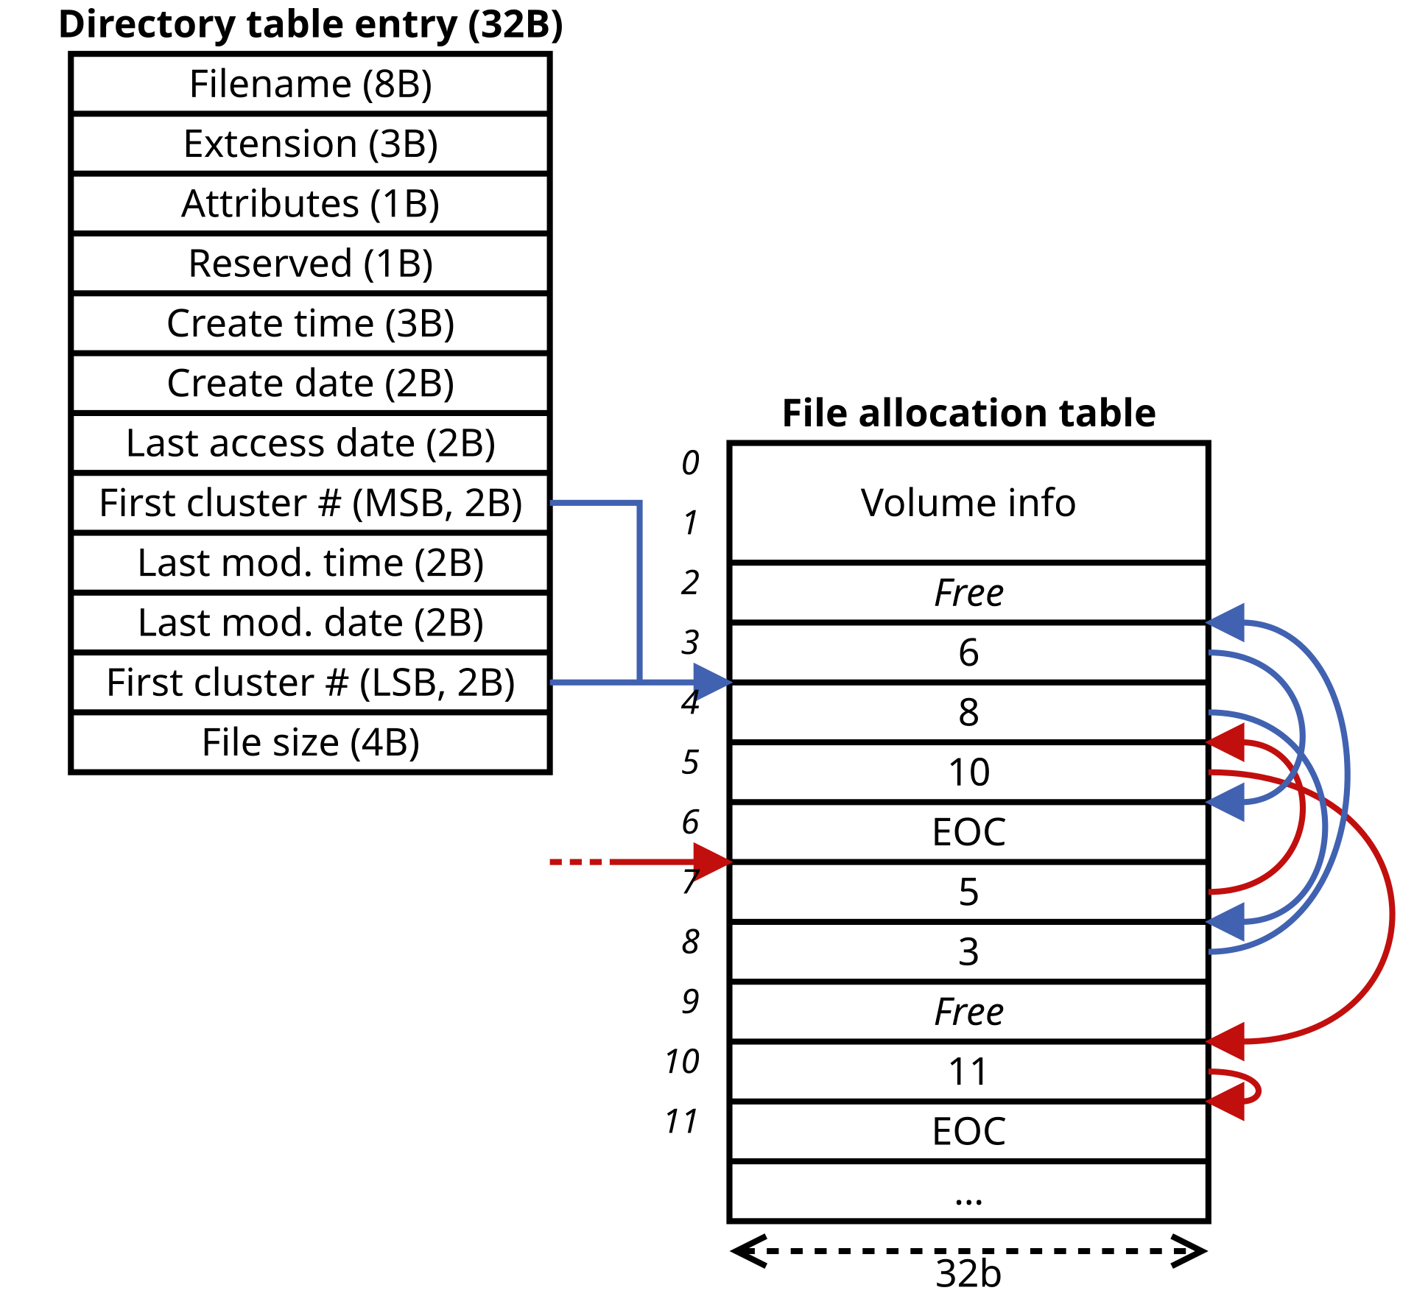
Disk partitions
Partitions have structures!

Slide 6
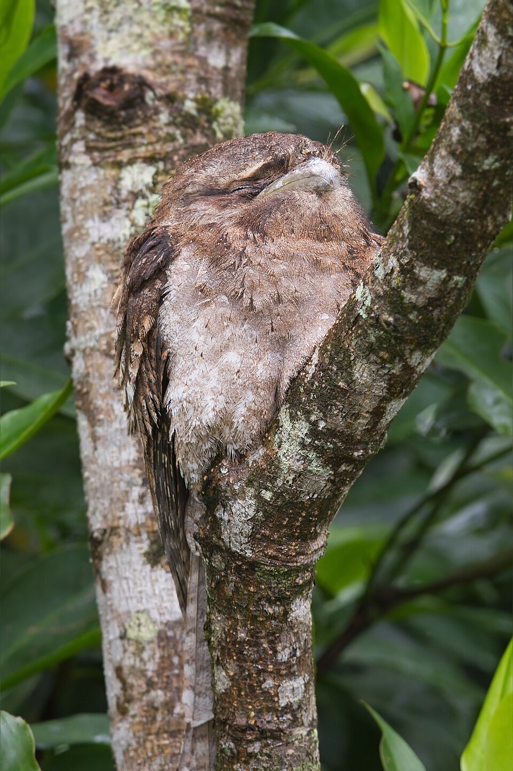
Delete ≠ Destroy
Deleting data = removing the pointer from the structure
The content is still there!
Free
Mark as free

Slide 7
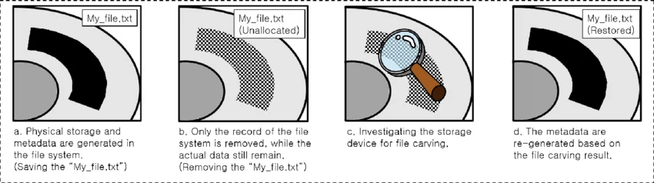
We can recover deleted files! (suppostly™)

Slide 8
Recovering files
Tools:
Testdisk
Sleuthdisk
Autopsy
FTK Imager … (and a lot more)
Carving files also works:
Binwalk
Foremost

Slide 9
Recovering files - The Sleuth Kit (TSK)
Check partitions (mmls)
List (fls -o <off> disk <inode>)
❯ mmls dds1-alpine.flag.img
DOS Partition Table
Offset Sector: 0
Units are in 512-byte sectors
Slot Start End Length Description
000: Meta 0000000000 0000000000 0000000001 Primary Table (#0)
001: ------- 0000000000 0000002047 0000002048 Unallocated
002: 000:000 0000002048 0000262143 0000260096 Linux (0x83)
❯ fls -o 2048 dds1-alpine.flag.img
d/d 10161: home
d/d 11: lost+found
r/r 12: .dockerenv
d/d 2033: bin
d/d 8129: boot
d/d 26418: root
…
Information (istat + fsstat)
Cat (icat -o <off> disk <inode>)
❯ istat -o 2048 dds1-alpine.flag.img 12
inode: 12
Allocated
Group: 0
Generation Id: 1464366224
uid / gid: 0 / 0
mode: rrwxr-xr-x
size: 0
num of links: 1
Inode Times:
(...)
Direct Blocks:
(...)
~/Downloads/reun
❯ icat -o 2048 dds1-alpine.flag.img 12
DEBUG_CHALL=0 ZIP_KEY=suprd0p3

Slide 10
Important file locations - Linux
Always check folders you would use!
Cool files
/home/<user>/Downloads
/home/<user>/Documents
/root
/tmp
/etc (for configs)
/var/log (for logs)
/home/<user>/.bash_history
/home/<user>/.<shell>_* (like .zsh_rc)
^ The same inside /root!

Slide 11
Important file locations - Windows
Always check folders you would use!
Cool files
C:\Users\<user>\Downloads
C:\Users\<user>\Desktop
C:\Users\<user>\AppData\*\temp
C:\temp
C:\ProgramData
C:\$MFT (Master File Table)
C:\System32\config\* (Registry Hives)
C:\Users\<user>\NTUSER.DAT
C:\Windows\System32\Winevt\Logs\*

Slide 12
Important file locations - Browsers
Check browsers folders for cookies, history and downloads!
Linux:
~/.config/<browser>/Default
~/.mozilla/firefox/Default
~/snap/<browser>/common/Default (installed with snap)
~/.var/app/<browser>/Default (installed with flatpak)
Windows:
%LocalAppData%\Google\Chrome\User Data\Default\
%LocalAppData%\Microsoft\Edge\User Data\Default\
%AppData%\Mozilla\Firefox\Profiles\*
Open the .db’s or use NIRSOFT’s (or lookup) parsing tools

Slide 13

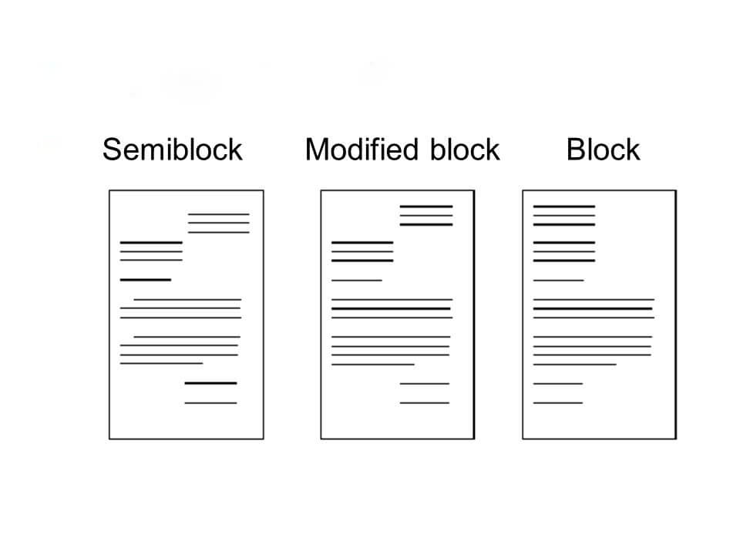
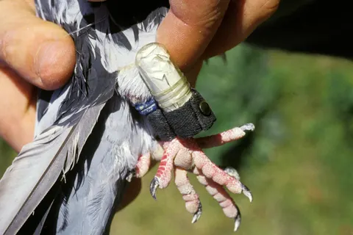
Network - packets

Slide 14
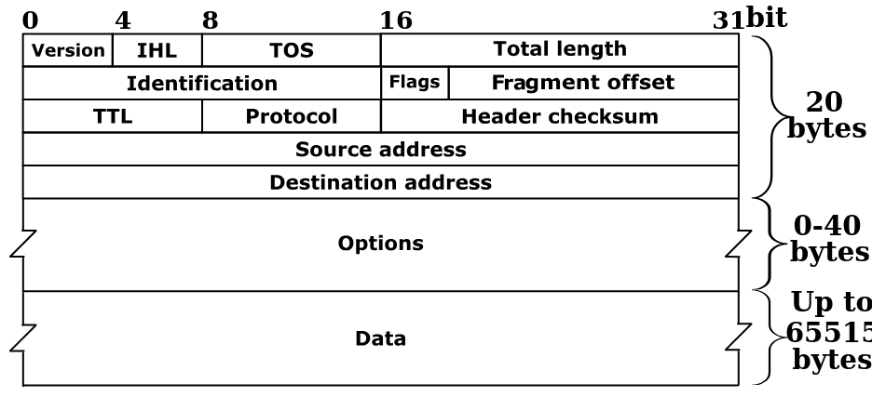
Network - packet structures

Slide 15
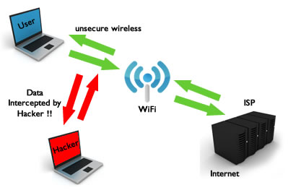
Network - We can sniff packets! (Wifi or router)

Slide 16
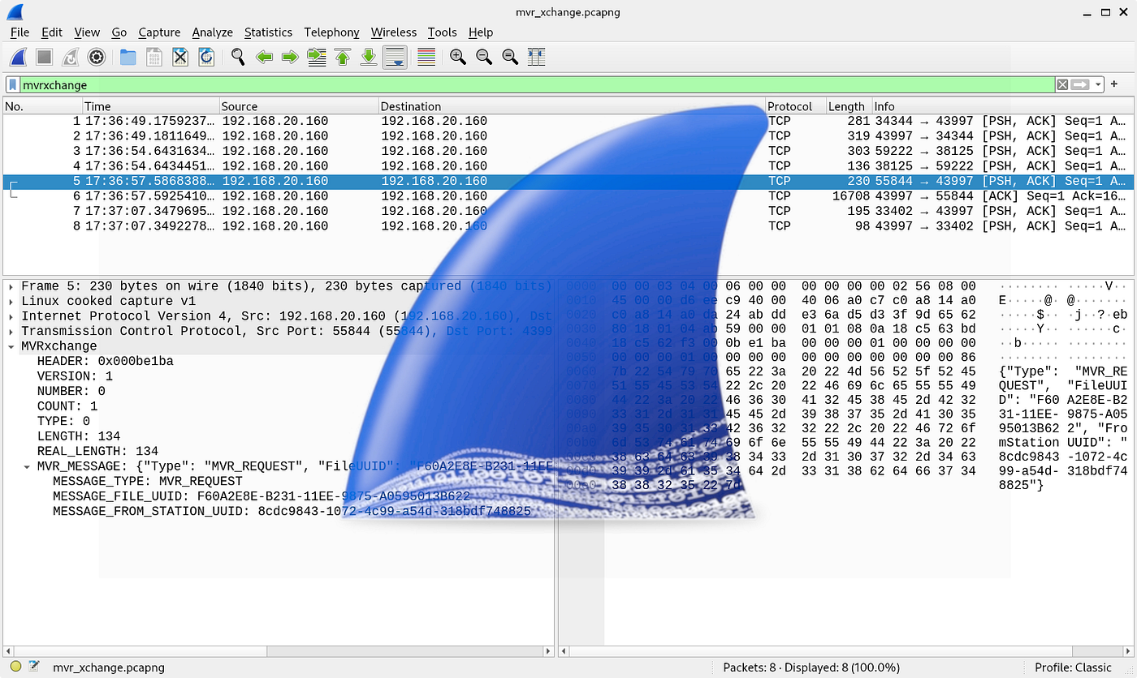
Network - Analyse packets - Wireshark

Slide 17
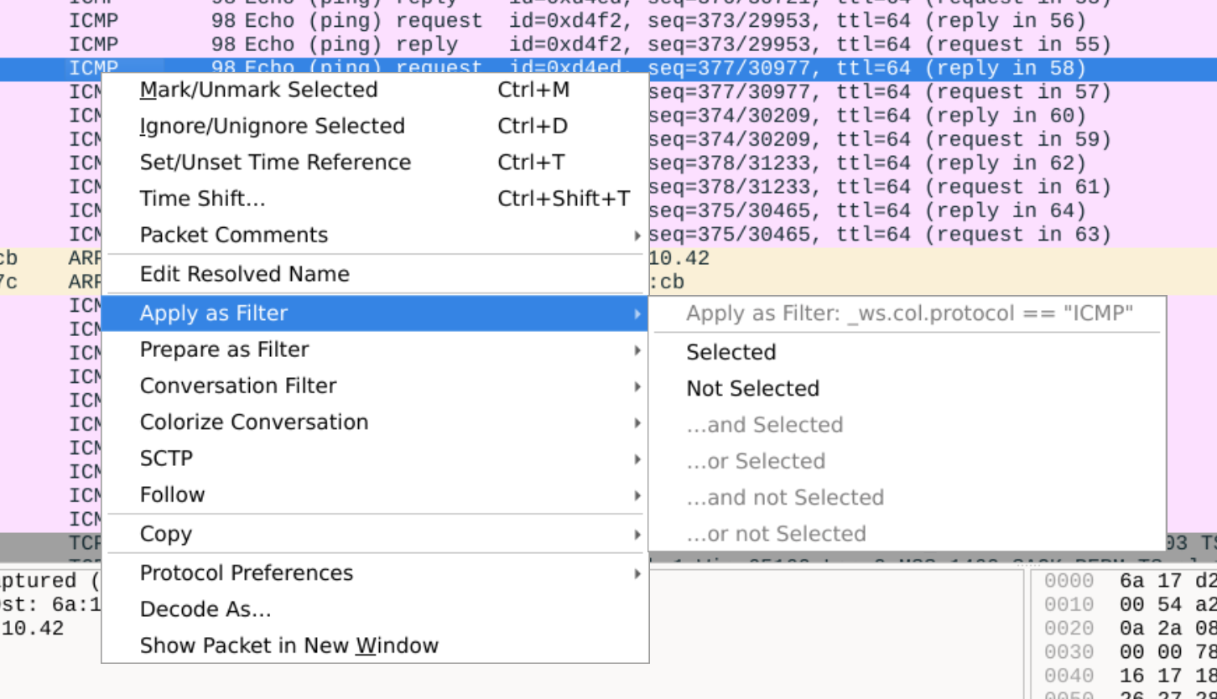

Wireshark - use filters!

Slide 18
Practice!
Solve challenges on CMU’s Cylab (picoCTF) - learn.cylabacademy.org
Try Sherlocks - hackthebox.com
(PS: root-me + Cyberdefenders)
PLAY CTFS!

